Slide 1
CSE 332
Computer Organization and Architecture
Lecture 3: Instruction Set Architecture

Slide 2
General Classification of ISA

Slide 3
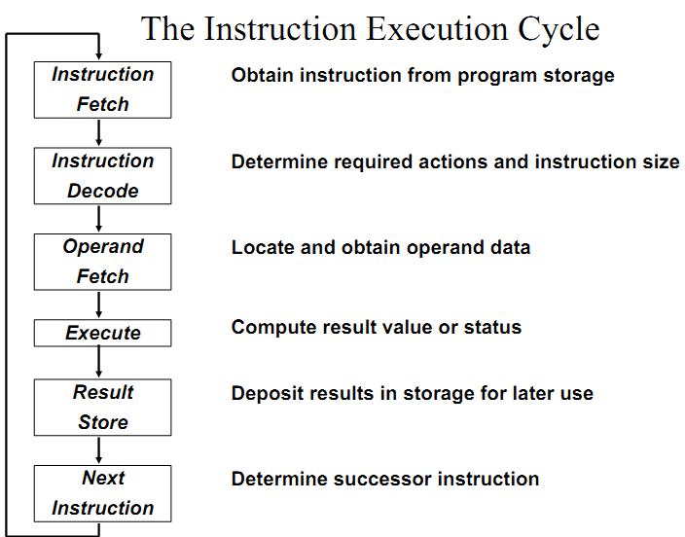
Instruction Set

Slide 4
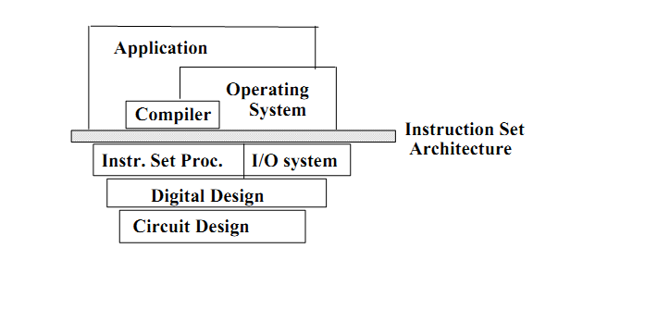
Instruction Set
To command a computer’s hardware, you must speak its language. The words
of a computer’s language are called instructions, and its vocabulary is called an
instruction set.

Slide 5
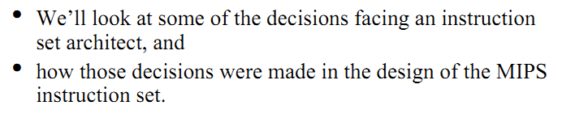
Instruction Set

Slide 6
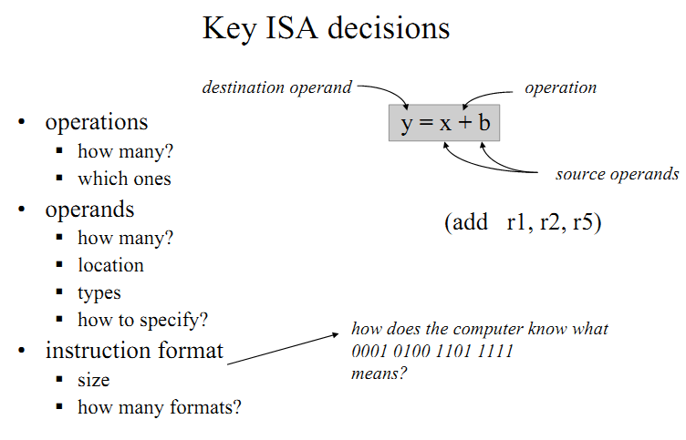
Instruction Set Architecture (ISA)

Slide 7
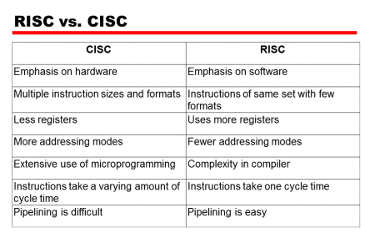
RISC vs. CISC

Slide 8
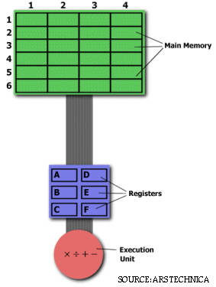
RISC vs. CISC
MULT 2:3, 5:2
CISC
vs.
RISC
LOAD A, 2:3
LOAD B, 5:2
PROD A, B
STORE 2:3, A

Slide 9
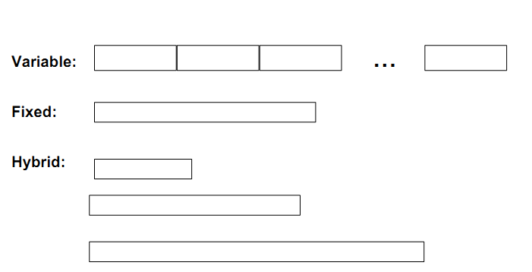
Instruction Length

Slide 10
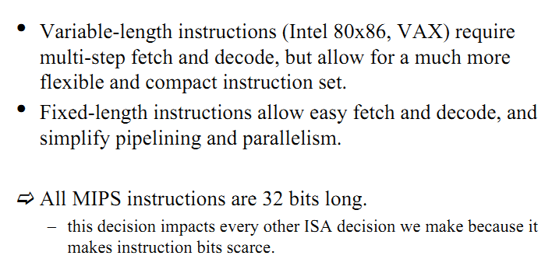
Instruction Length

Slide 11
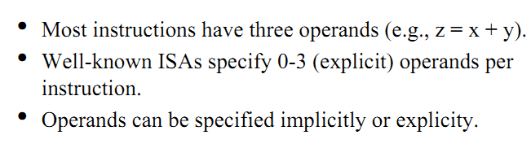
How many Operands?

Slide 12
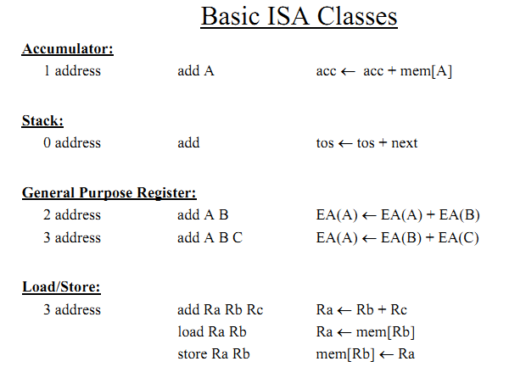
How many Operands?

Slide 13
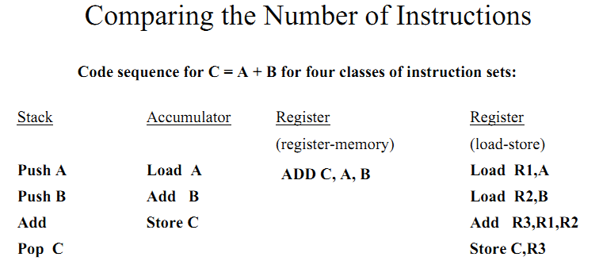
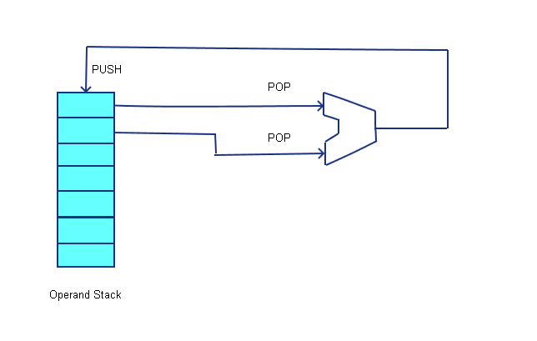
How many Operands?
Burroughs 6500, 7500

Slide 14
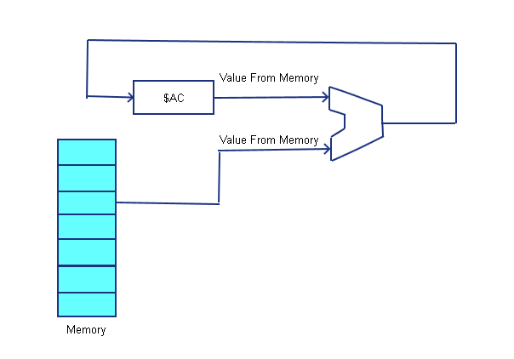
How many Operands?
Intel 8080, PDP-8

Slide 15
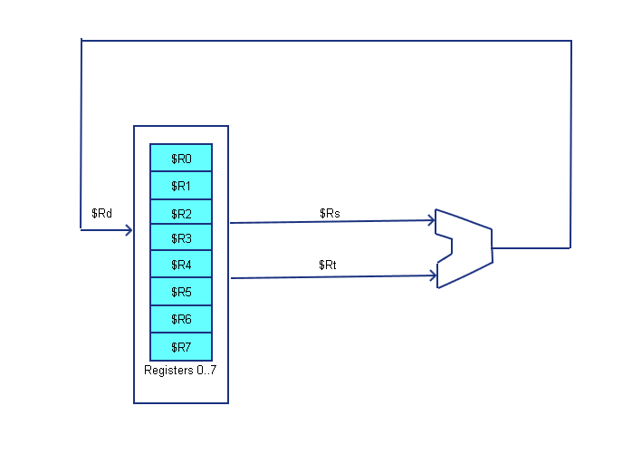
How many Operands?

Slide 16
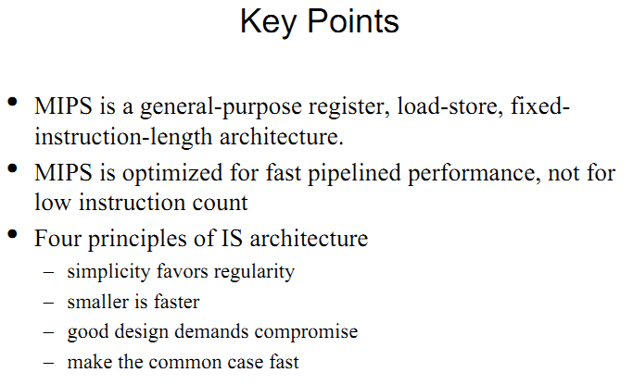
Instruction Set

Slide 17
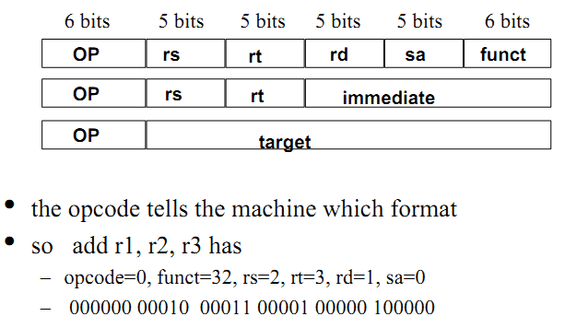
MIPS Instruction Formats

Slide 18
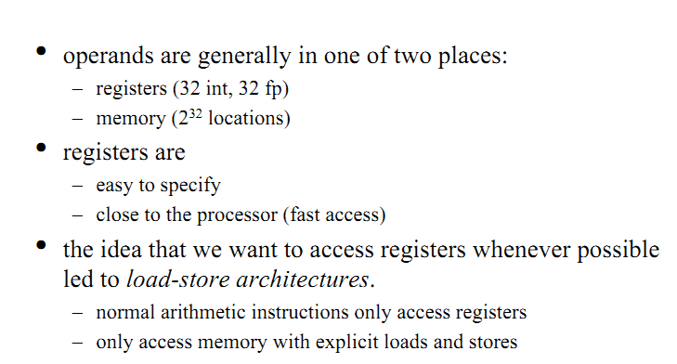
Accessing the operands

Slide 19
Instruction Set
Register Number | Conventional Name | Usage
$0 | $zero | Hard-wired to 0
$1 | $at | Reserved for pseudo-instructions
$2 - $3 | $v0, $v1 | Return values from functions
$4 - $7 | $a0 - $a3 | Arguments to functions - not preserved by subprograms
$8 - $15 | $t0 - $t7 | Temporary data, not preserved by subprograms
$16 - $23 | $s0 - $s7 | Saved registers, preserved by subprograms
$24 - $25 | $t8 - $t9 | More temporary registers, not preserved by subprograms
$26 - $27 | $k0 - $k1 | Reserved for kernel. Do not use.
$28 | $gp | Global Area Pointer (base of global data segment)
$29 | $sp | Stack Pointer
$30 | $fp | Frame Pointer
$31 | $ra | Return Address

Slide 20
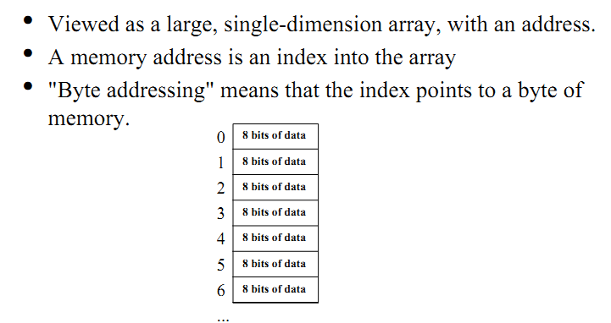
Memory Organization

Slide 21
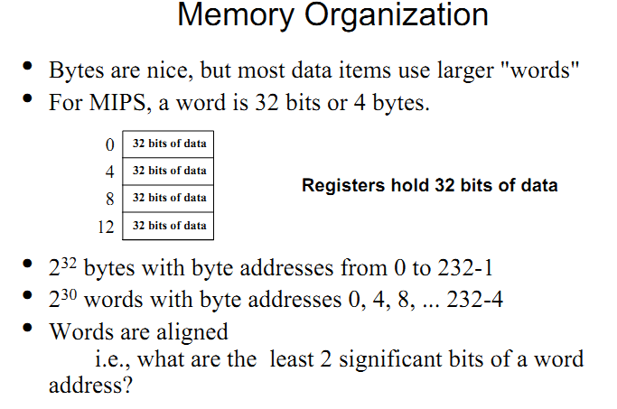
Memory Organization

Slide 22
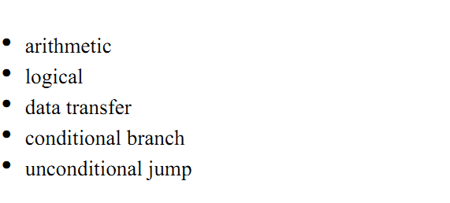
Which instructions

Slide 23
MIPS Addressing Modes

Slide 24
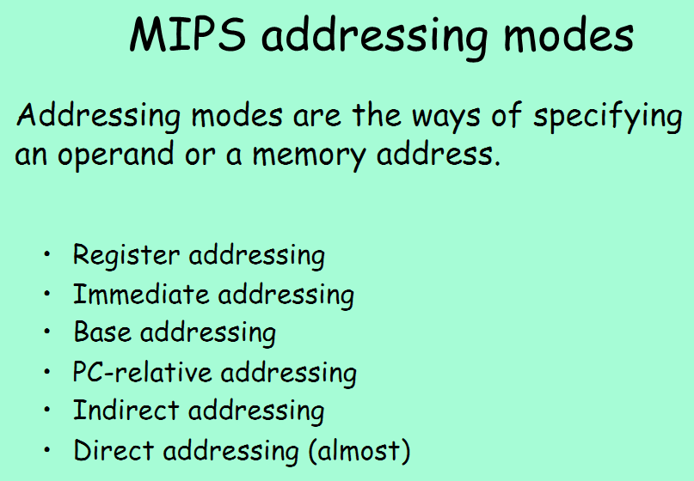
Addressing Modes

Slide 25
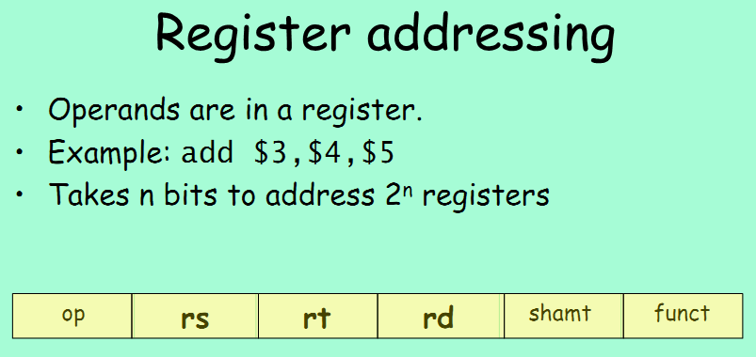
Addressing Modes

Slide 26
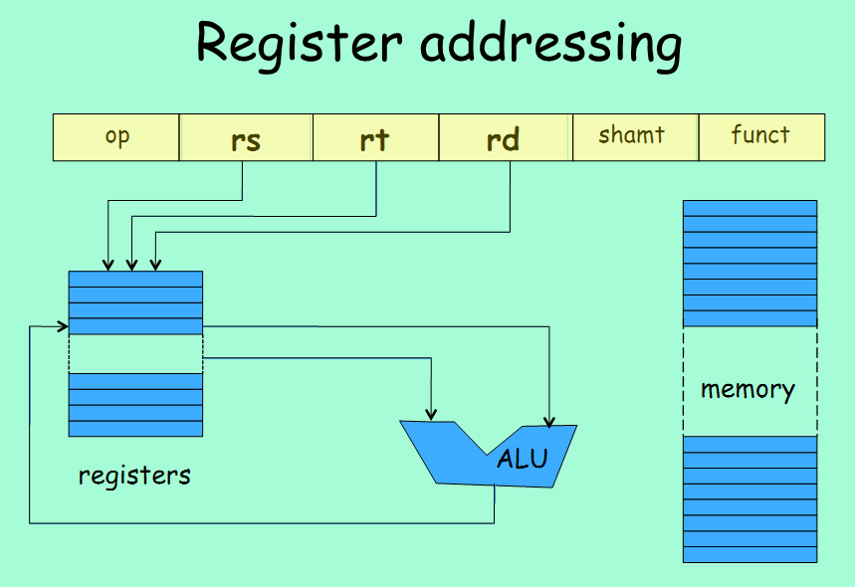
Addressing Modes

Slide 27
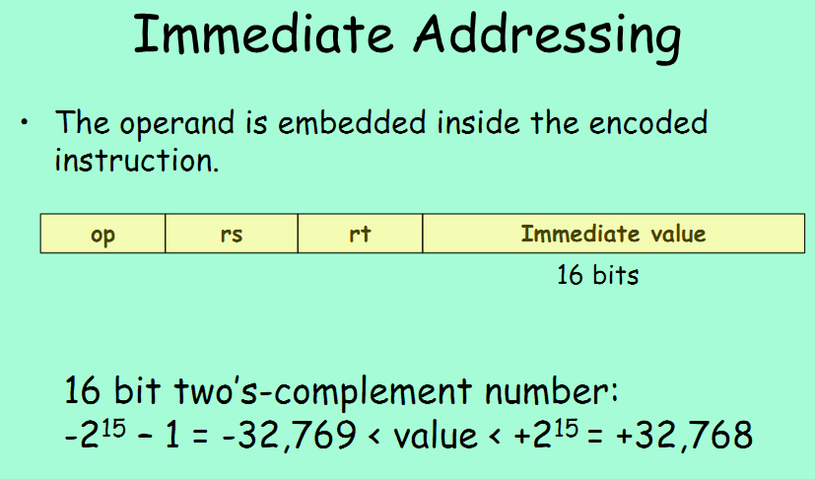
Addressing Modes

Slide 28
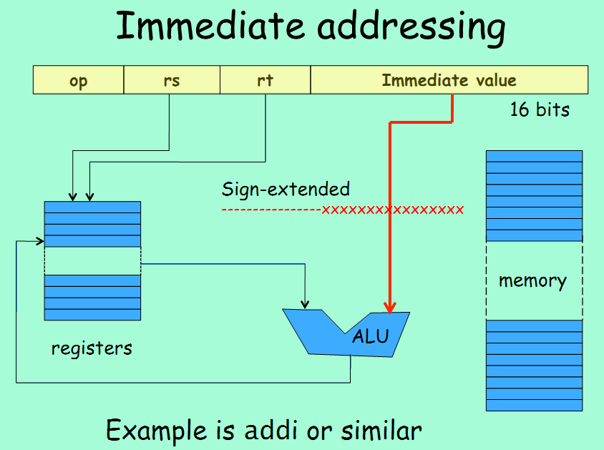
Addressing Modes

Slide 29
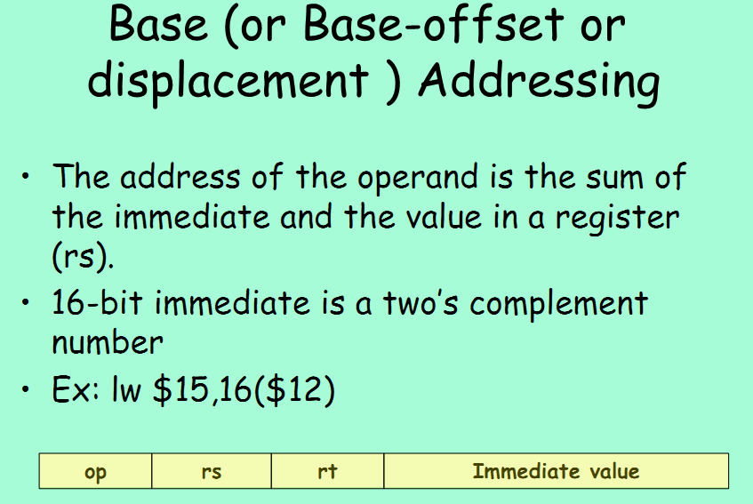
Addressing Modes

Slide 30
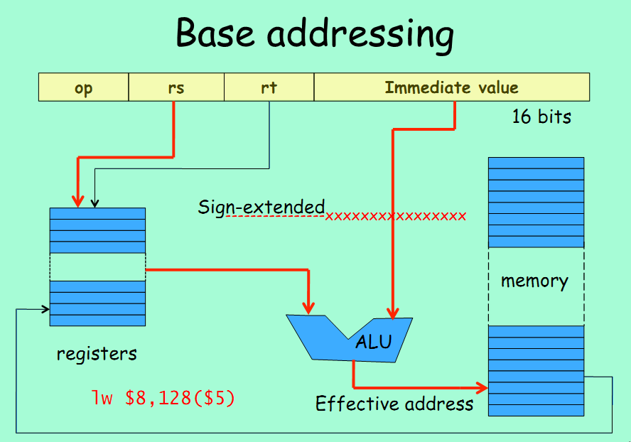
Addressing Modes

Slide 31
MIPS Instructions

Slide 32
A Basic MIPS Instruction
C code: a = b + c ;
Assembly code: (human-friendly machine instructions)
add a, b, c # a is the sum of b and c
Machine code: (hardware-friendly machine instructions)
00000010001100100100000000100000
Translate the following C code into assembly code:
a = b + c + d + e;

Slide 33
Example
C code a = b + c + d + e;
translates into the following assembly code:
add a, b, c add a, b, c
add a, a, d or add f, d, e
add a, a, e add a, a, f
Instructions are simple: fixed number of operands (unlike C)
A single line of C code is converted into multiple lines of
assembly code
Some sequences are better than others… the second
sequence needs one more (temporary) variable f

Slide 34
Subtract Example
C code f = (g + h) – (i + j);
Assembly code translation with only add and sub instructions:

Slide 35
Subtract Example
C code f = (g + h) – (i + j);
translates into the following assembly code:
add t0, g, h add f, g, h
add t1, i, j or sub f, f, i
sub f, t0, t1 sub f, f, j
Each version may produce a different result because
floating-point operations are not necessarily
associative and commutative… more on this later

Slide 36
Operands
In C, each “variable” is a location in memory
In hardware, each memory access is expensive – if
variable a is accessed repeatedly, it helps to bring the
variable into an on-chip scratchpad and operate on the
scratchpad (registers)
To simplify the instructions, we require that each
instruction (add, sub) only operate on registers
Note: the number of operands (variables) in a C program is
very large; the number of operands in assembly is fixed…
there can be only so many scratchpad registers

Slide 37
Registers
The MIPS ISA has 32 registers (x86 has 8 registers) –
Why not more? Why not less?
Each register is 32-bit wide (modern 64-bit architectures
have 64-bit wide registers)
A 32-bit entity (4 bytes) is referred to as a word
To make the code more readable, registers are
partitioned as $s0-$s7 (C/Java variables), $t0-$t9
(temporary variables)…

